Slide 1


Uber Data Analysis
ICS-474: Big Data Analytics
Presented by
Abdullah Alfateel - 202037380
Hashem Almubarak - 202012260
Haidar Alnasser - 202027820

Slide 2

Objectives of the Study
Analyze ride patterns to understand customer needs.
Identify trip purposes and popular routes.
Address class imbalance for better predictions.
Enhance decision-making for business strategies.

Slide 3

Dataset Overview
Source: Uber ride data
Number of rows: 1155
Key columns:
Categorical: START_DATE, END_DATE, CATEGORY, START, STOP, PURPOSE
Numerical: MILES
Purpose: Understand trip behaviors for classification and prediction.

Slide 4


Data Exploration
Key Insights:
Most trips are for business purposes (mode = Business).
Average trip distance: 10.5 miles (mean).
Start and stop location: Cary is the most frequent.
Tools Used:
Python’s pandas, NumPy, and Matplotlib for data exploration.

Slide 5
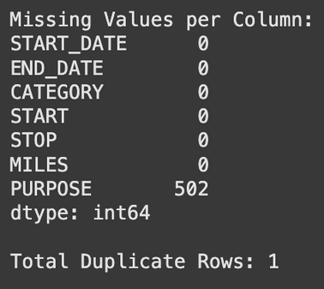
Missing Values and Duplicates
Missing Values
Duplicates
Identified and removed 1 duplicate row.
Purpose column: ~50% missing values.
Filled with “Unknown” for continuity.

Slide 6
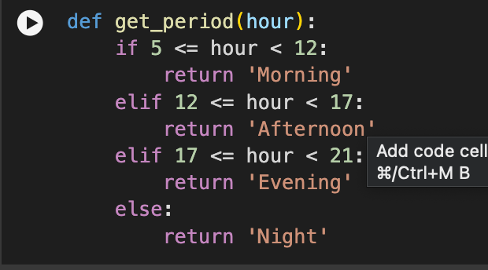
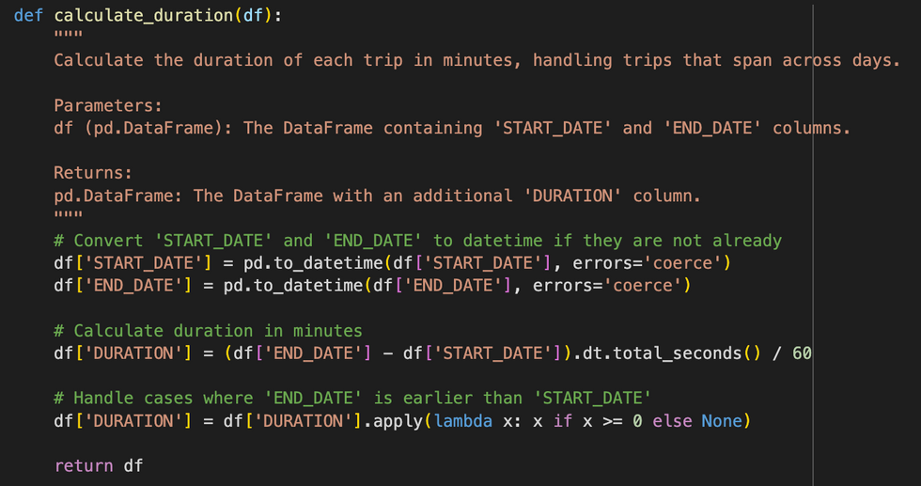
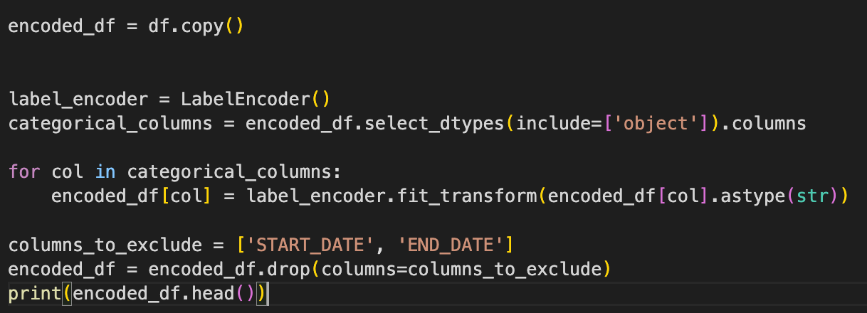
Data Preprocessing
Handling Missing Data
Handling Missing Data:
Numerical: Median imputation for MILES.
Categorical: Mode imputation for PERIOD and DAY_OF_WEEK.
Encoding
Label Encoding for periods.
One-Hot Encoding for locations.

Slide 7
Modeling Approach
Algorithms Used
Logistic Regression, Random Forest, and Linear Regression.
Class Imbalance:
Addressed using SMOTE.
Regression Models:
Linear Regression to predict trip distance (MILES).

Slide 8
Results and Insights
Random Forest:
Accuracy: ~90%
Balanced classification after SMOTE.
Linear Regression:
R² for MILES prediction: ~0.57.
Insights:
Business trips dominate (~90%).
Frequent locations: Cary.
High precision for predicting ‘Business’ trips.

Slide 9
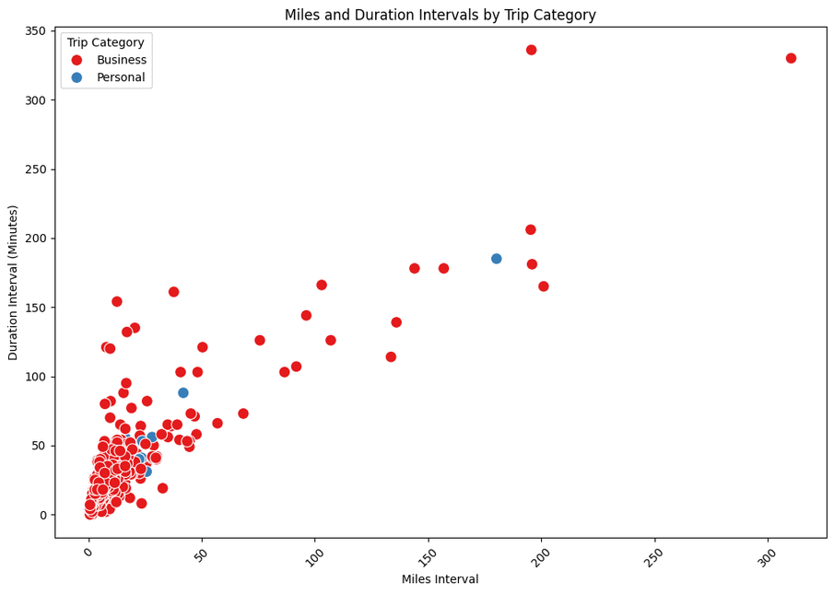
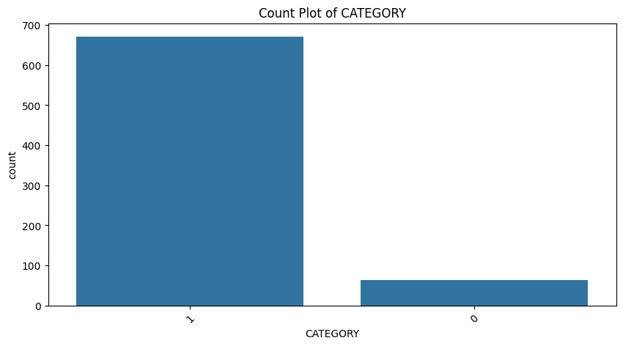
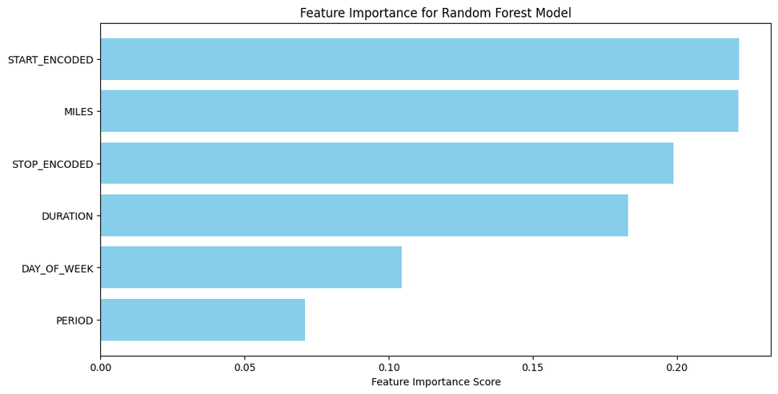
Data Visualizations
Miles Distribution: Most trips are short.
Category Distribution: Business trips dominate.
Feature Importance:
PURPOSE and START are the most predictive.

Slide 10

Improvements and Validation
Techniques Used:
SMOTE for oversampling.
Stratified splitting for fair representation.
K-Fold Cross-Validation for robustness.
Recommendations:
Improve features (e.g., trip cost).
Gather more data to reduce imbalance.

Slide 11
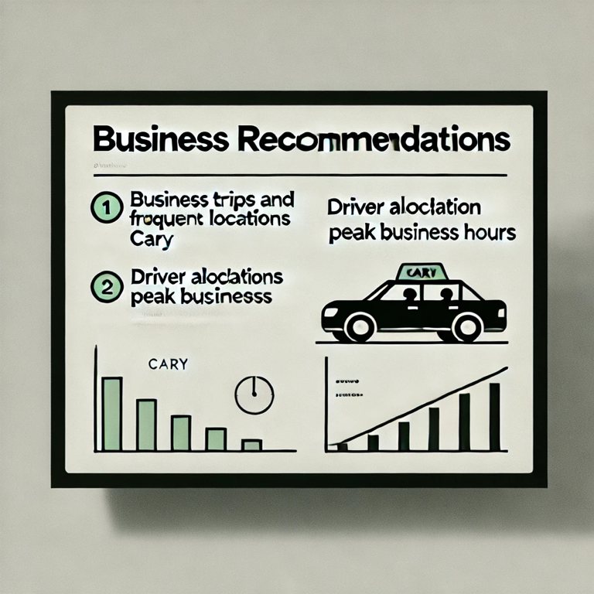
Business Recommendations
Focus Areas:
Business trips and frequent locations like Cary.
Optimize:
Driver allocation during peak business hours.
Routes for popular start and stop locations.

Slide 12
Challenges Faced
Small dataset: Limited insights and generalizability.
Class imbalance: Personal trips underrepresented.
Time constraints: Limited scope for exploring advanced models.

Slide 13

Future Work
Explore additional datasets for richer insights.
Integrate deep learning models for more accurate predictions.
Focus on real-time data for dynamic recommendations.

Slide 14

Thank you very much!

